Slide 1
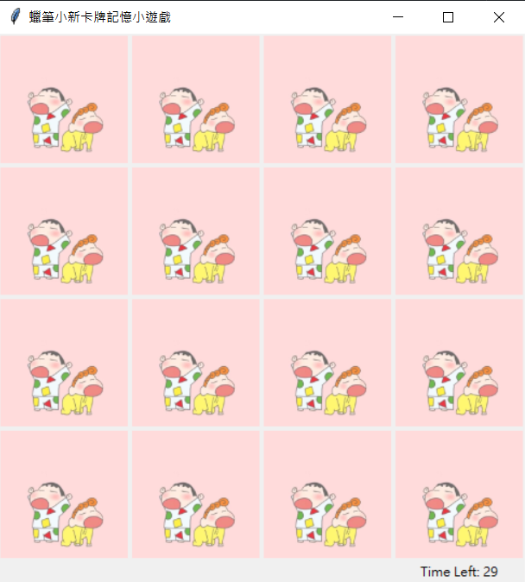
Crayon Shin-chan
Memory game
10840129 張耀云
10844129 李函諭

Slide 2
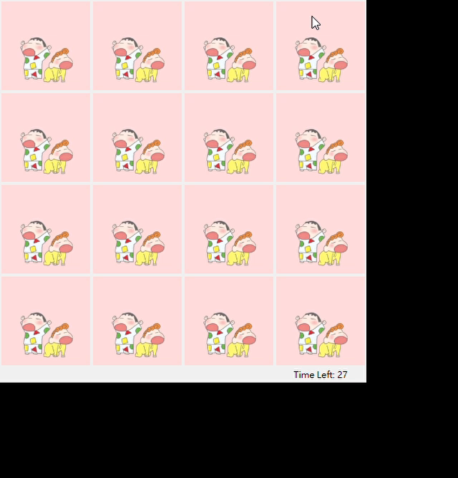
execution screen

Slide 3
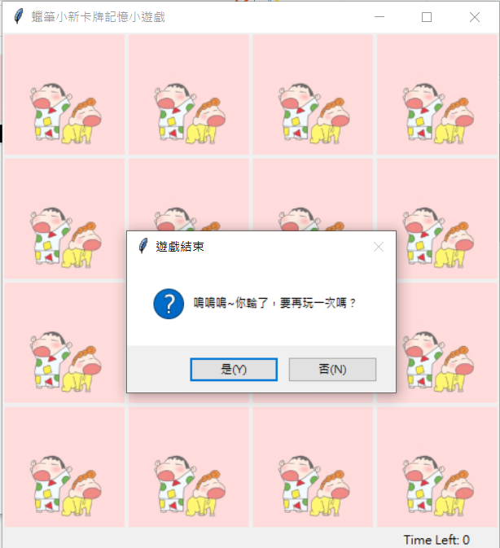
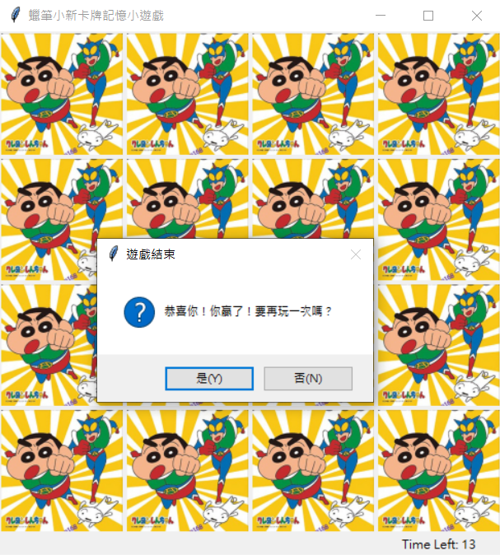
Game over
Lose Win

Slide 4
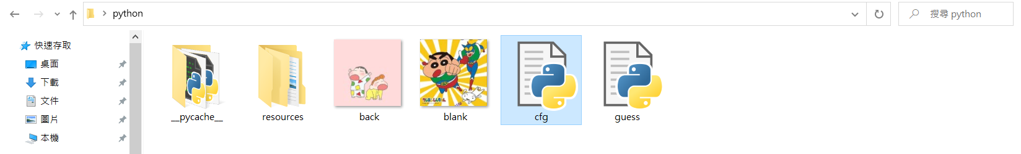
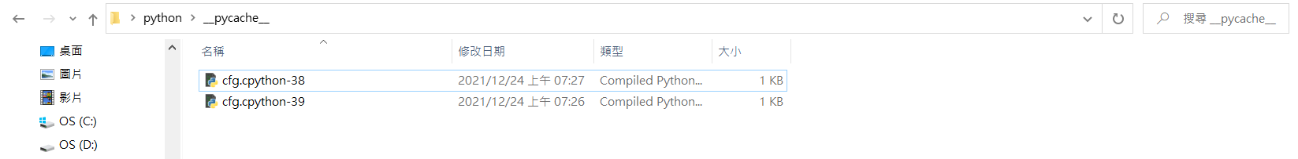
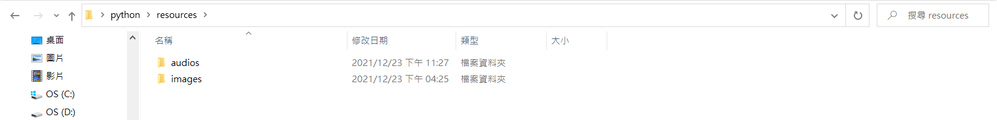
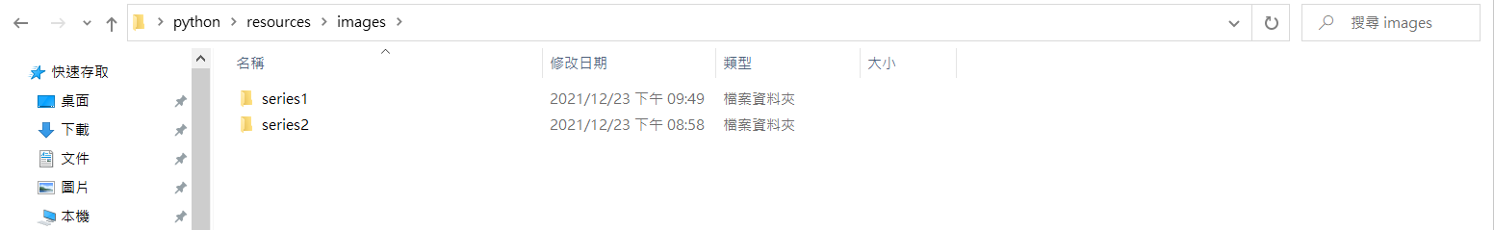
File folder

Slide 5
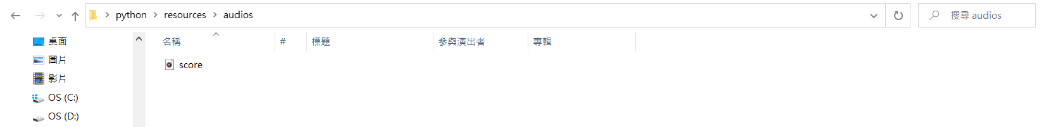
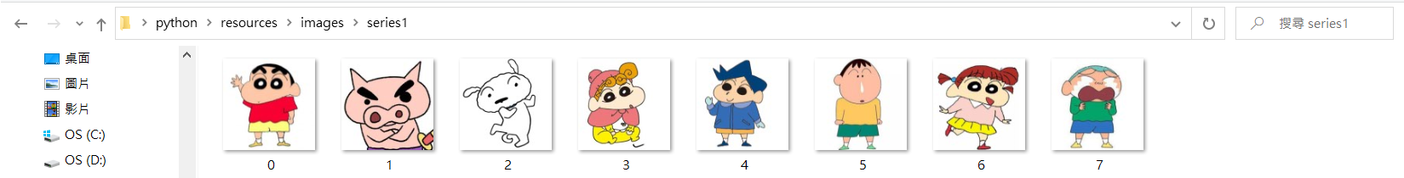
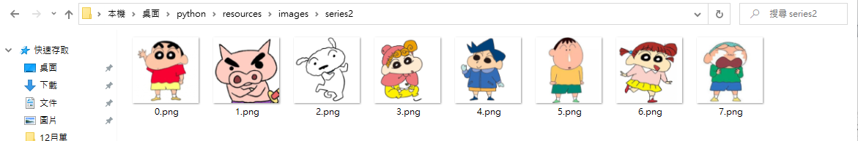
File folder

Slide 6
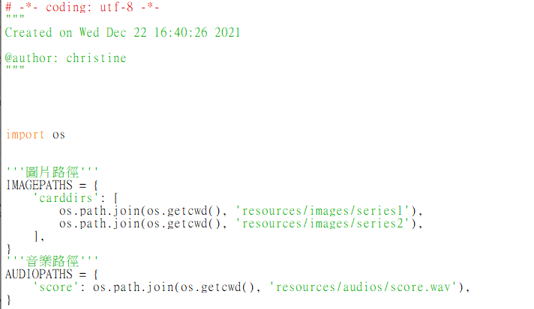
Minor file - cfg.py
123
Set the paths of images and audio

Slide 7
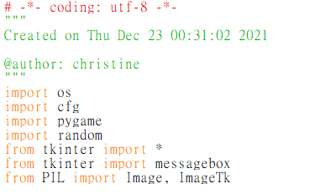
Major file - guess.py
Import External file
os : setting ‘images’ and ‘audio’ paths.

Slide 8
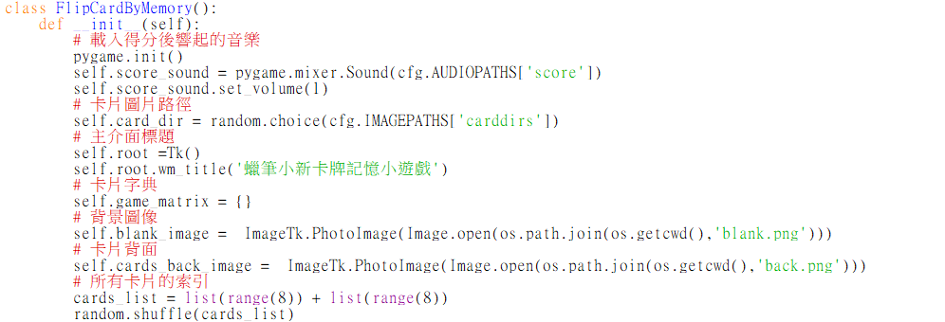


Major file - guess.py
Class FlipCardByMemory()
Set: music, images, title, card-blank, card-back, time
card_list, random

Slide 9
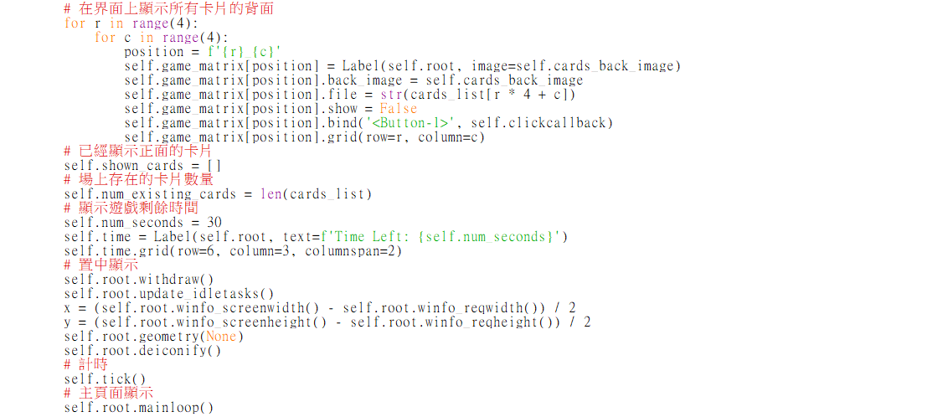
Major file - guess.py
Class FlipCardByMemory()
f-strings have an f at the beginning and
curly braces containing expressions that will be replaced with their values.
When r=0, c=0
Create label
Read back(image)
Name random(image) =0 and Hide
Click the left mouse button Call function ”clickcallback”

Slide 10
Major file - guess.py
Class FlipCardByMemory()
Set the list for opening card
Set the num of existing cards, for ending the game
Set the position
Set the clock

Slide 11
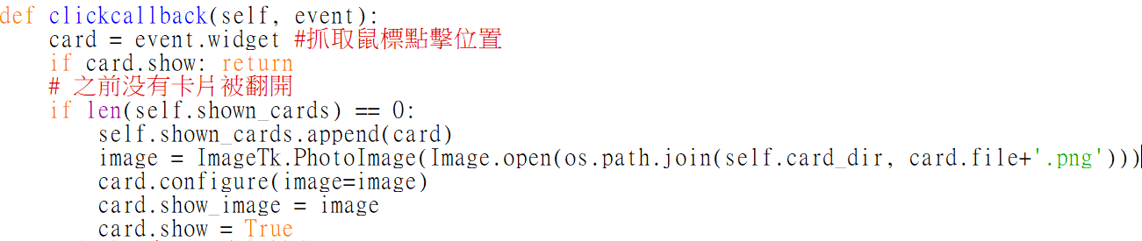
Major file - guess.py
def clickcallback(self, event)
123
Grab the position of the mouse click
The number of cards already displayed is 0
Add the “card” into the list “shown_cards”
Store the selected card
Open the card

Slide 12
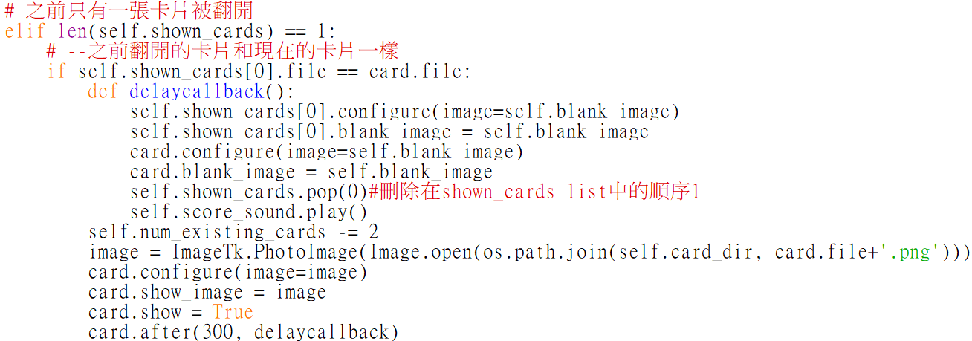
Major file - guess.py
def clickcallback(self, event)
def delaycallback()
Control two identical cards into
another pattern
123
The number of cards already displayed is 1
The same two cards ➔ call delaycallback()
delete the first position in the list “shown cards”

Slide 13
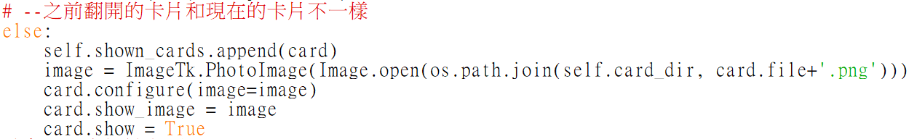
Major file - guess.py
def clickcallback(self, event)
123
The number of cards already displayed is 1
The same two cards ➔ call delaycallback()
The different two cards
Add the second “card” into the list “shown_cards”
Store the selected card
Open the card

Slide 14
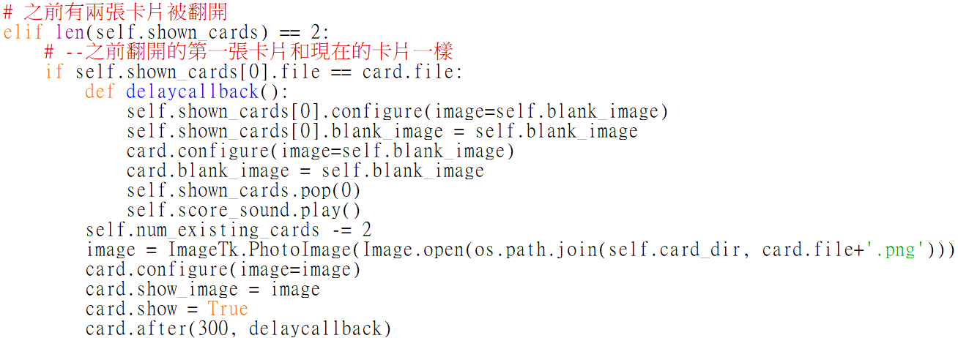
Major file - guess.py
def clickcallback(self, event)
def delaycallback()
Control two identical cards into
another pattern
123
The number of cards already displayed is 2
The same two cards ➔ call delaycallback()
Same as the previous step

Slide 15
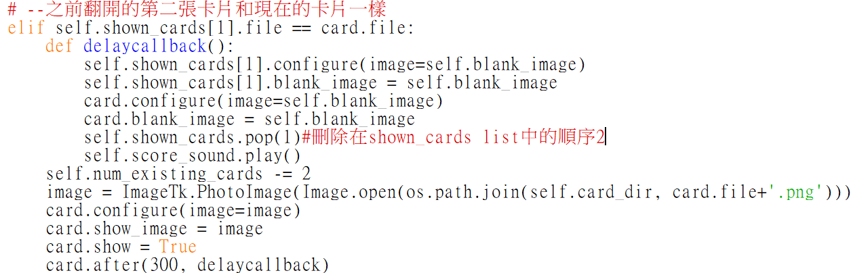
Major file - guess.py
def clickcallback(self, event)
def delaycallback()
Control two identical cards into
another pattern
123
The number of cards already displayed is 2
The second card is the same as the current card ➔ call delaycallback()
delete the second position in the list “shown cards”

Slide 16
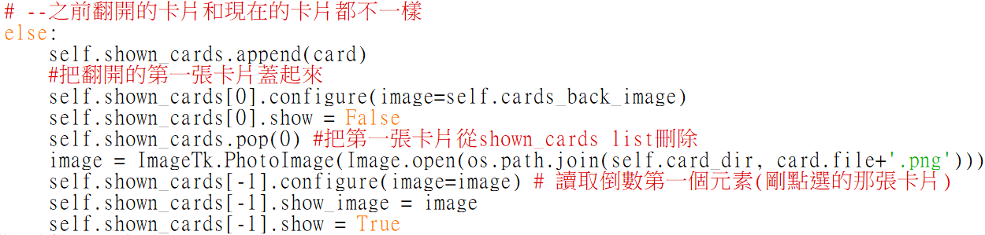
Major file - guess.py
def clickcallback(self, event)
123
The number of cards already displayed is 2
The both of the cards are different to the current card
Add the current card “card” into the list “shown_cards”
Cover up the first opened card
Show the current card

Slide 17
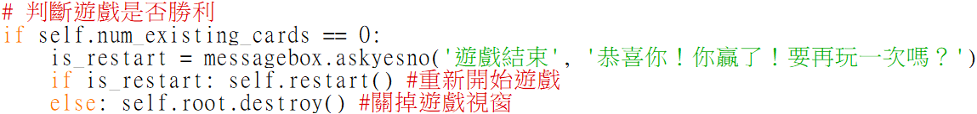
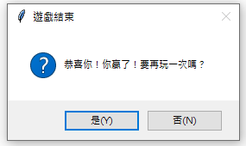
Major file - guess.py
def clickcallback(self, event)
123
When the list “num_existing_cards” is 0
Restart
Destroy

Slide 18
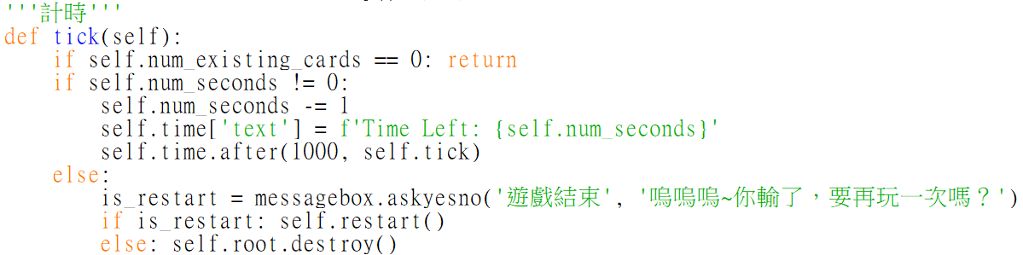
Major file - guess.py
def tick(self)
123
When the list “num_existing_cards” is 0
When the time “num_seconds” not 0
Minus 1 (second) until it equals 0 or the game is successful

Slide 19
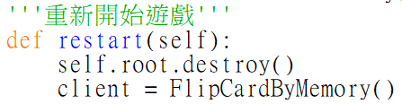
Major file - guess.py
def restart(self)
123
When call the “def restart”
Delete the original game
Call again the class “FlipCardByMemory()”

Slide 20
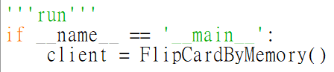
Major file - guess.py
123

Slide 21
Thank you for
your listening

